Slide 1
Are We In a Recession? Who’s Right?

Slide 2
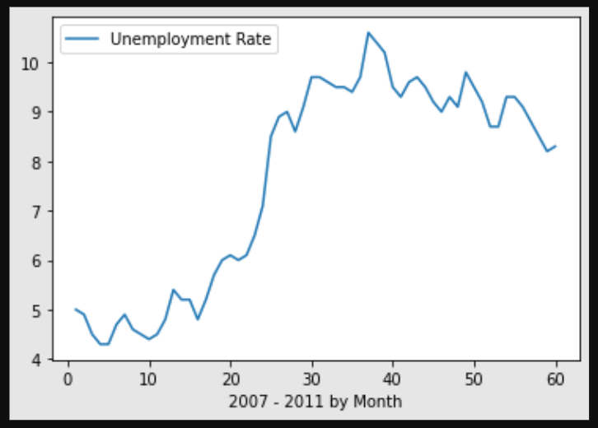
2007 - 2011 Unemployment Rates
The unemployment rate in 2008 opened at 5.4% and ended at 7.1%
The effects of the recession reached a peak in 2010 aat 10.6%
By the end of 2011 the rate had slowly dropped to 8.3%
Source: Bureau of Labor Statistics

Slide 3
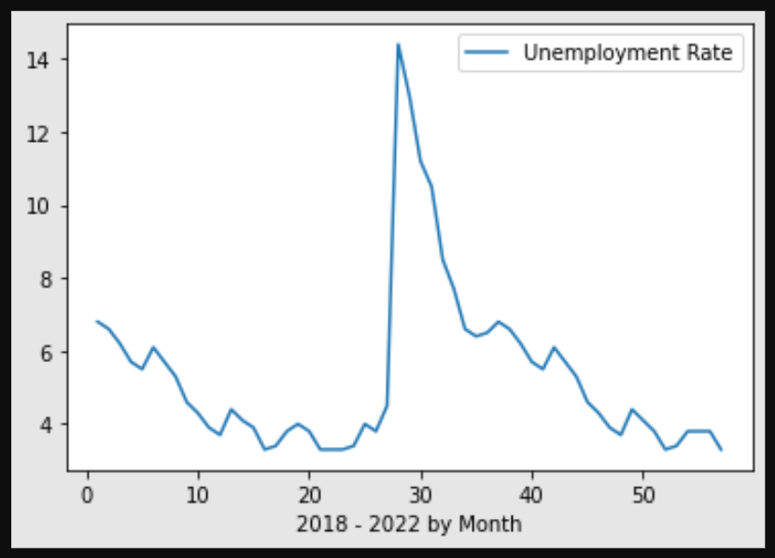
2018 - 2022 Unemployment Rate
The unemployment rate jumped from 4.5% to 14.4% in April, 2020
By the end of December, 2021 the rate had dropped back down to 3.7%
Source: Bureau of Labor Statistics

Slide 4
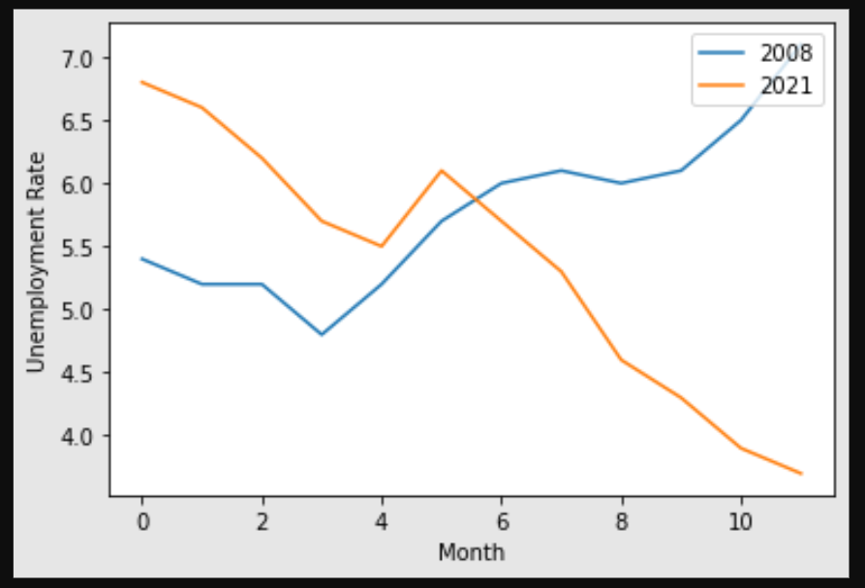
Comparison between 2008 and 2021
The unemployment rate steadily increased in 2008 before peaking in 2010, however the current rate in 2021 is nearly 4% lower than it was in 2008 and on a continual trend downwards in an opposite direction than occurred in 2010.
The current trend is optimistic but dramatic external events could affect the rate like in 2020.
Source: Bureau of Labor Statistics

Slide 5
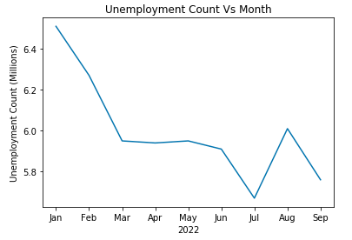
Unemployment 2022
The count in the unemployed has decreased over the last 3 quarters.
Despite the slowing of GPD over last two quarters, jobs are being filled, and has not showed slowing.
A possible shift upwards with seasonal jobs coming to an end.

Slide 6
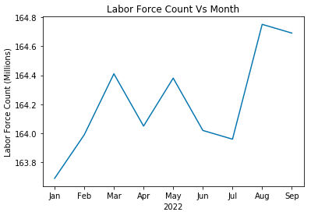
Labor Force in 2022
Overall Labor Force has been increasing over the last 9 months of reporting. Teetering on 1M new job seekers in the market.
Recessions tend to see a downturn in labor force as people get discouraged and drop out.
Cyclical data is also accounted for.

Slide 7
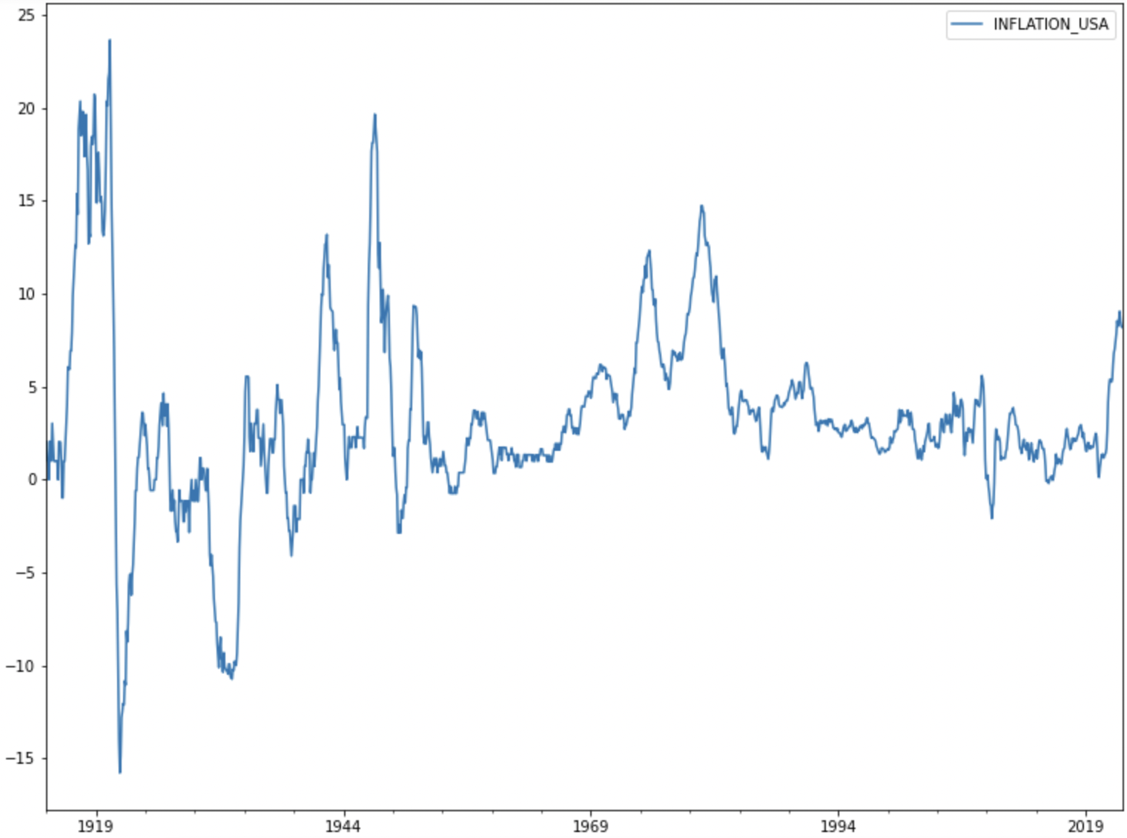
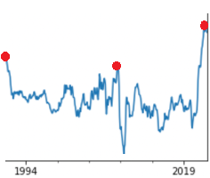
Inflation Rates USA
Although inflation is healthy for a growing economy, very high rates of inflation can cause a recession.
Key Dates include:
2020 Covid-19
2008 Mortgage crisis
2001 Y2K
Historically, when a recession sets in, inflation begins to fall.

Slide 8
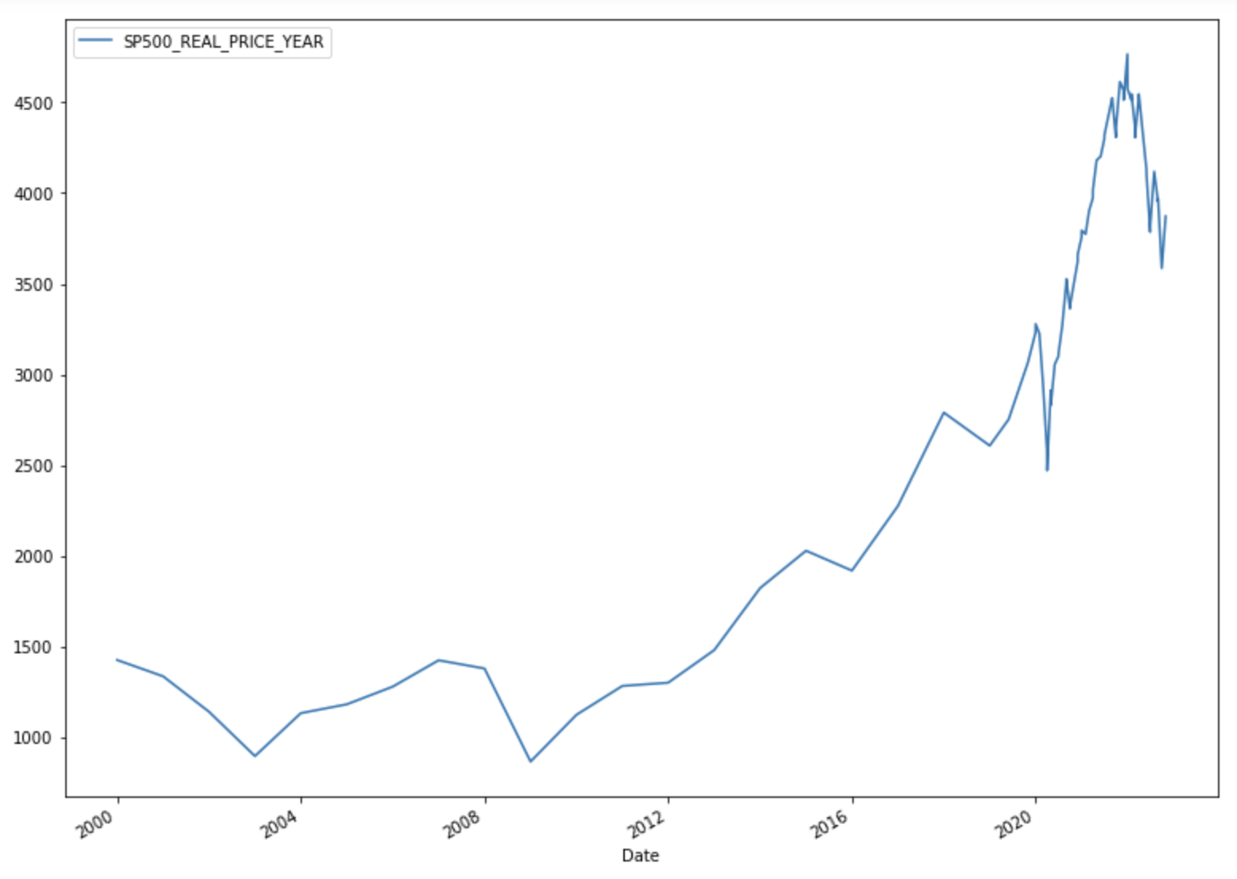
S&P 500
What is the S&P 500?
Standard & Poor’s 500 Index features 500 of leading US publicly traded companies market cap.
The S&P 500 is generally the best indicator of how US stocks are doing overall.
Following every recession, the S&P decreases just around 34% and just these last 2 year it has dropped 24%.
Something to note: The following data shows real prices of the S&P without adjusting to inflation.

Slide 9
Conclusion
There are many indicators at play in a recession that we also did not cover. Of which include:
High Interest Rates
Gross Domestic Product and Consumer Price Index
Real Income
Although GDP has shrank for two consecutive quarters which is often considered a recession, it’s not an official definition. It is clear however, that based on past trends we are getting closer to a recession and that the economy is struggling. There is reason to believe that rapid job growth and investment from foriegn countries do not indicate a recession right now.

